Slide 1
Factors Driving Employee Retention
DDSAnalytics
Quynh Chau
December 5, 2019

Slide 2
Assumptions and Data Source
Analysis on factors affecting employee turnover/retention was based on the most recent 12-month period employment data.
Data contains 870 records, with 36 variables grouped into the categories below:
Personal Influencers
Age
Education level
Compensation Influencers
Percent of Last Pay Increase
Longevity
Influencers
Years at company
Marital status
Gender
Distance from home
Years in the workforce
Years in current role
Last performance rating
Stock option level
Years since last promotion
Years with current manager
Years in current role
Work Environment Influencers
Environmental satisfaction
Job involvement
Job satisfaction
Relationship satisfaction
Work life balance
Monthly income/Monthly rate/Hourly rate
Training times last year
Over18
Education field
Business travel
Miscellaneous
Department
Job role
Overtime
Standard hours
Attrition
Numbers of companies worked

Slide 3
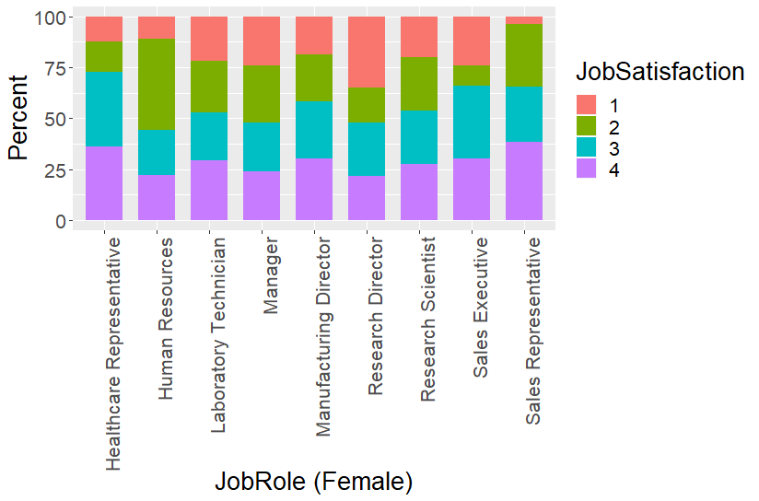
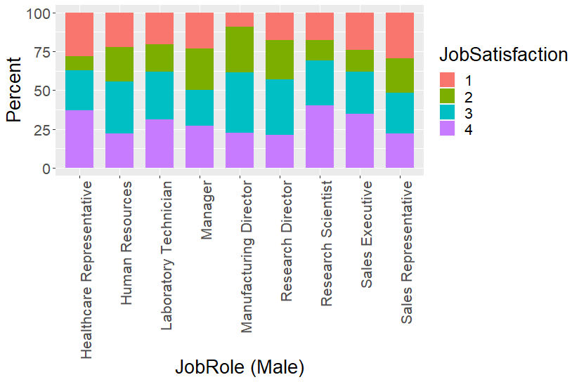





Job Satisfaction Among Different Job Roles by Gender
Observations:
For women employees: roles with the highest percentage (>35%) of job satisfaction (highest = 4) include Healthcare and Sales Representative; Women research directors had the highest percentage of job dissatisfaction (lowest rating = 1). Women in HR, managerial, and research director roles have the highest percentage of job dissatisfaction with at least 50% of their ratings were 1&2.
For men employees: roles with the highest percentage (approx. > 35%) of job satisfaction (highest = 4) include Healthcare Representative and Research Scientist; Male sales representatives tend to have the highest percentage (approx. > 35%) of job dissatisfaction (lowest rating = 1). Men in managerial and sales representative roles have the highest percentage (at least 50% ) of job dissatisfaction (ratings = 1 & 2).

Slide 4
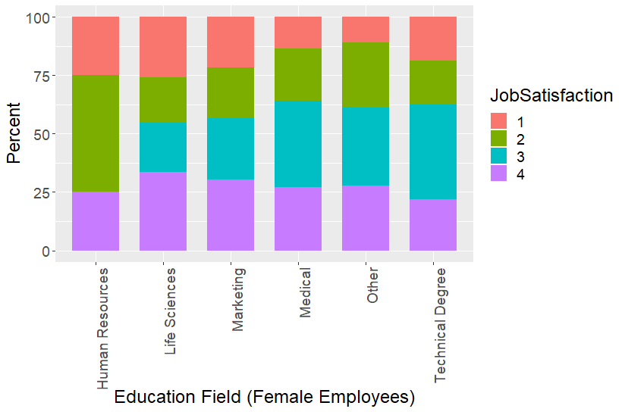
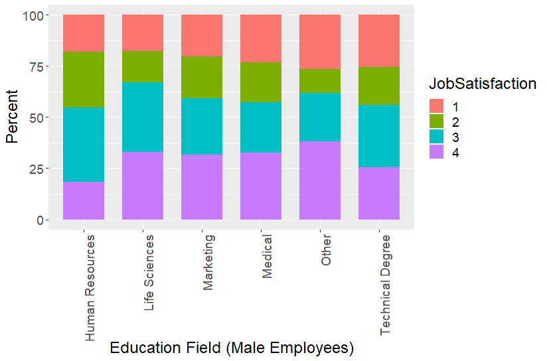

Job Satisfaction Among Different Education Field by Gender
Observations:
For both men and women, those in Human Resources and Technical fields seem to have less job satisfaction; the percentage of 1/2/3 ratings for these two fields are disproportionately higher than for other fields.
For both men and women, Life Sciences and Medical professions tend to have higher job satisfaction as measured by the relative percentage of 3/4 ratings.

Slide 5
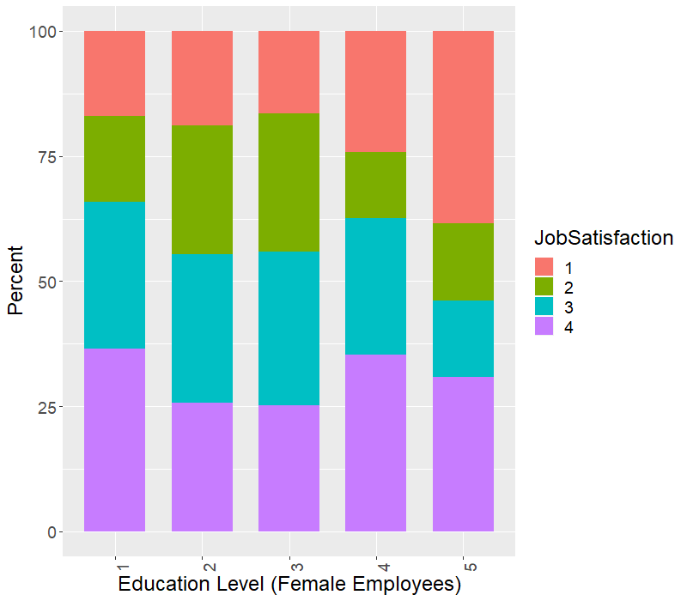
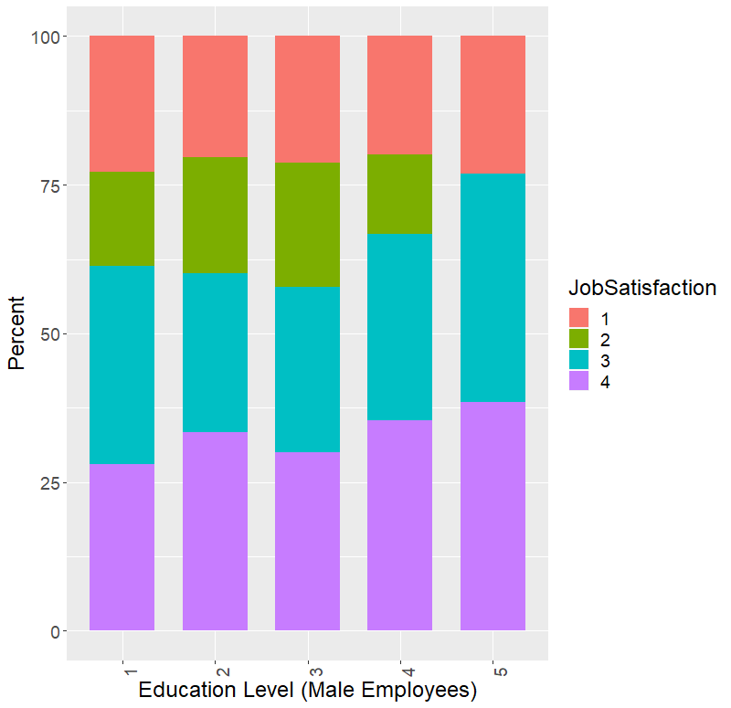
Job Satisfaction Among Different Education Level by Gender
Observations:
Female Employees at highest education level (rating – 5) seem to be less satisfied in their jobs (rating = 4 & 3) than their peer group and male employees at the same educational level.
In general, male employees who have higher education level tend to have a relatively higher percentage of people who are more satisfied in their jobs (ratings = 3 or 4).

Slide 6
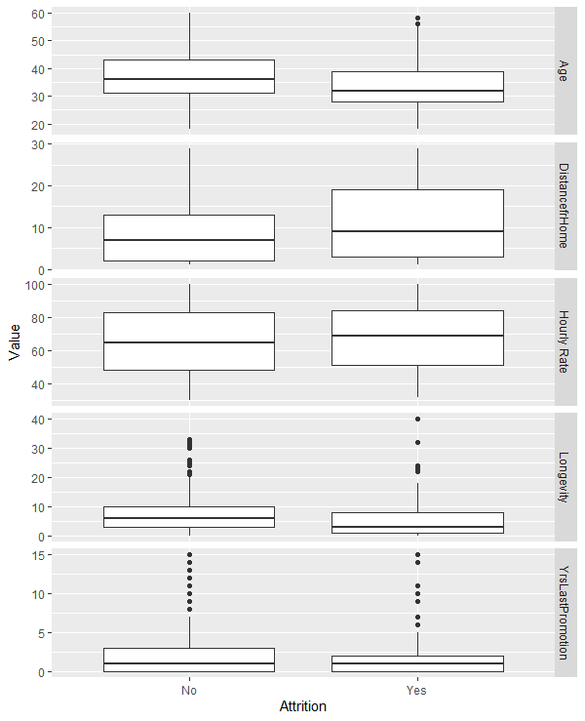
Characteristics of Attrition
Employees in the Atttrition category (“Yes”) tend to be:
Younger in average age (around <= 30)
Longer distance from home
<=5 years of longevity at work
Higher average hourly rate
Surprisingly, advancement as measured by Years since last promotion doesn’t seem to be a differentiating factor for attrition

Slide 7
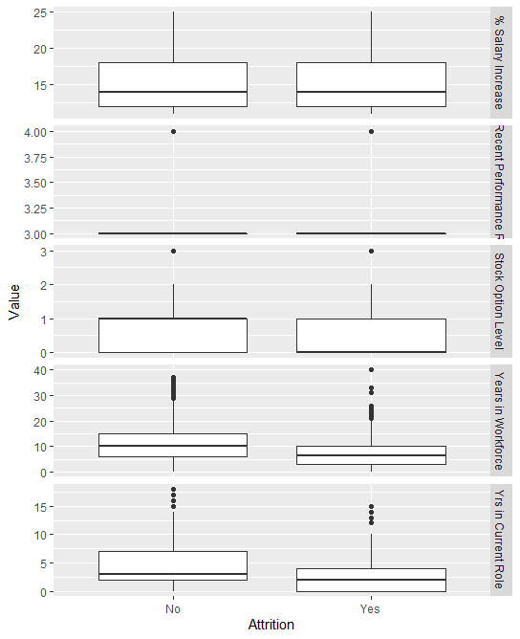
Characteristics of Attrition
Differentiating factors for Attrition include the following:
Lower stock option level,
Less years in workforce
<5 years in current role
Interestingly, % salary increase (a reflection of compensation) and Performance rating do not seem to be strong differentiators for attrition.

Slide 8
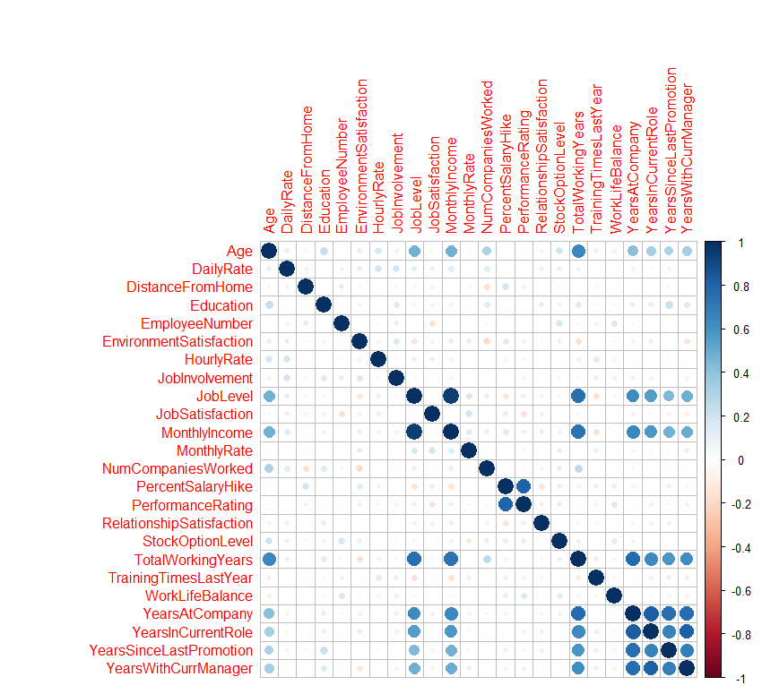

Attrition = Yes
Attrition = No
Observation: Superficially, correlations of variables among those employees classified as Attrition – Yes or No appear to be similar. But there may be varying degrees of differences within some factors of variables that may be indicative of being an influencer for attrition.

Slide 9
Summary of Naïve Bayes Models
NBModelNames Accuracy Sensitivity Specificity
1: Personal Influencers 0.8494 0.8503 0.8000
2: Compensation Influencers 0.8414 0.8434 0.6250
3: Longevity Influencers 0.8310 0.8401 0.2308
4: Work Environment Influencers 0.8494 0.8570 0.6452
5: Miscellaneous 0.8448 0.8546 0.5806
The following Personal Influencers are the best predictors of Attrition:
Age
Over18
Education level
Education field
Marital status
Gender
Distance from home
Video Link: https://youtu.be/gr9eFGLucos

